Slide 1


SlotDiffusion: Object-Centric Generative Modeling with Diffusion Models NeurIPS 2023 (Spotlight) Ziyi Wu, Jingyu Hu*, Wuyue Lu*, Igor Gilitschenski, Animesh Garg
(* equal contribution)

Slide 2
Object-Centric Learning (OCL)
OC representation
Capture objects with separate features (slots)
E.g. RoI-Pooling from bbox
Locatello, Francesco, et al. "Object-centric learning with slot attention." NeurIPS. 2020.
Notes:
To begin with, what is object-centric learning? Given an image of multiple objects, if you apply a CNN model to extract a feature map, that is called global representation. In contrast, OC rep captures each object with one separate feature called slot, such as RoI-Pooling an object bbox

Slide 3
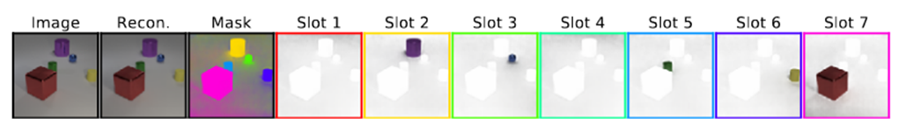
Object-Centric Learning (OCL)
OC representation
Capture objects with separate features (slots)
E.g. RoI-Pooling from bbox
Unsupervised OCL
The emergence of objectness
Video credit:
Kipf, Thomas, et al. "Conditional Object-Centric Learning from Video." ICLR. 2022.
Notes:
In this paper, we study unsupervised OCL. We want to segment objects from images without using any labels or consistently track objects in videos

Slide 4
Application – Generation Tasks
Compositional generation: slots as semantic concepts
Singh, Gautam, Fei Deng, and Sungjin Ahn. "Illiterate DALL-E Learns to Compose." ICLR. 2022.
Wu, Ziyi, et al. "SlotFormer: Unsupervised Visual Dynamics Simulation with Object-Centric Models." ICLR. 2023.
Notes:
OCL enables more generalizable and interpretable algorithms. For example, in compositional generation, the model discovers semantically meaningful visual concepts, and perform controllable generation

Slide 5
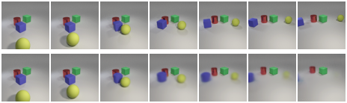
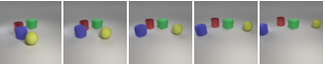
Application – Generation Tasks
Compositional generation: slots as semantic concepts
Video prediction: explicitly reason interactions & preserve object identities
Input
Future Rollout
ConvLSTM
Slot-based
Singh, Gautam, Fei Deng, and Sungjin Ahn. "Illiterate DALL-E Learns to Compose." ICLR. 2022.
Wu, Ziyi, et al. "SlotFormer: Unsupervised Visual Dynamics Simulation with Object-Centric Models." ICLR. 2023.
Notes:
In video prediction, the model explicitly reasons the spatio-temporal interactions over objects, leading to more consistent object appearance and accurate dynamics

Slide 6
Motivation – Data Complexity
GT
Prediction
GT
Prediction
Prior works:
Results on simple datasets are good
Cannot scale to complex ones!
GT
Prediction
GT
Prediction
Wu, Ziyi, et al. "SlotFormer: Unsupervised Visual Dynamics Simulation with Object-Centric Models." ICLR. 2023.
Notes:
However, prior works only experiment on visually simple data, but cannot scale up to complex data with rich textures and backgrounds

Slide 7
Motivation – Data Complexity
GT
Prediction
GT
Prediction
Prior works:
Results on simple datasets are good
Cannot scale to complex ones!
Why?
The dynamics (object motion) are okay
Slot-to-image decoding is weak!
GT
Prediction
GT
Prediction
Wu, Ziyi, et al. "SlotFormer: Unsupervised Visual Dynamics Simulation with Object-Centric Models." ICLR. 2023.
Notes:
Interestingly, the predicted object motions are roughly correct, and thus the bottleneck is the slot-to-image decoding module, which cannot produce high-quality images from slots

Slide 8
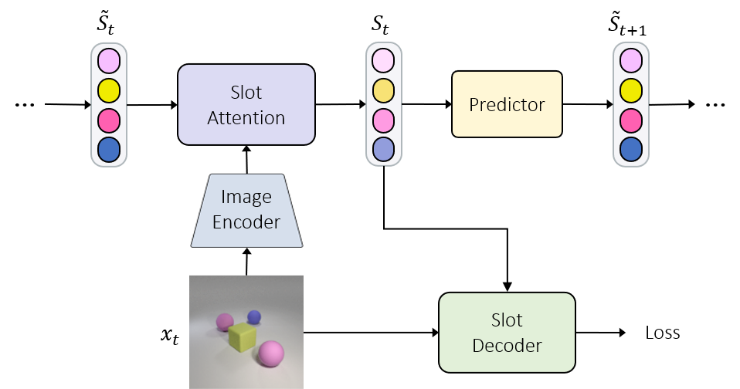
Background – Slot Attention for Video
OC models: Image Encoder, Slot Attention, Slot Decoder, Predictor
Encoder: extract image features
Notes:
Now, let’s review some video slot models, which typically consist of 4 modules. Given one frame, an image encoder first extracts feature maps

Slide 9
Background – Slot Attention for Video
OC models: Image Encoder, Slot Attention, Slot Decoder, Predictor
Slot Attention: update object slots
Notes:
which are used to update slots via Slot Attention

Slide 10
Background – Slot Attention for Video
OC models: Image Encoder, Slot Attention, Slot Decoder, Predictor
Decoder: reconstruct inputs as training signal
Notes:
Next, a slot decoder reconstructs input images from slots, and the recon loss is our training signal

Slide 11
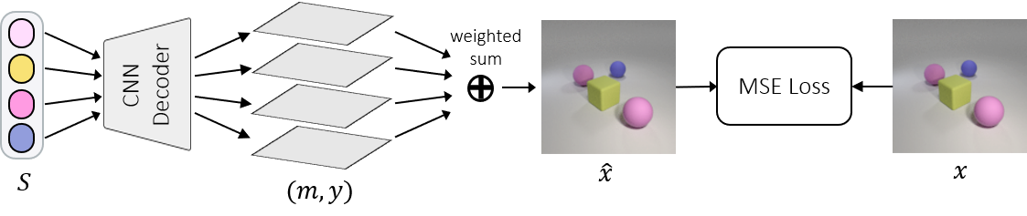
Prior Works – SAVi
SAVi uses a Deconv-based CNN decoder
Reconstruct RGB pixels
Kipf, Thomas, et al. "Conditional Object-Centric Learning from Video." ICLR. 2022.
Notes:
To dig deeper, the pioneering work SAVi uses a Deconv-based CNN decoder, which upsamples slots to recon RGB pixels

Slide 12
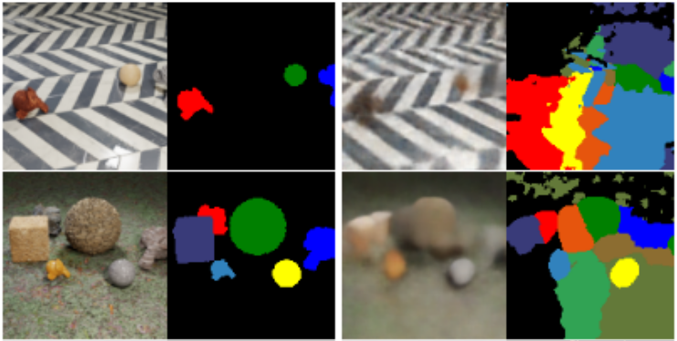
Prior Works – SAVi
SAVi uses a Deconv-based CNN decoder
Reconstruct RGB pixels
Biased towards low-level features e.g. color statistics
Only work on uniform-color objects
Image
GT
Segmentation
Kipf, Thomas, et al. "Conditional Object-Centric Learning from Video." ICLR. 2022.
Notes:
However, such design biases the model towards low-level color stats, and thus cannot work on images with textured objects and backgrounds

Slide 13
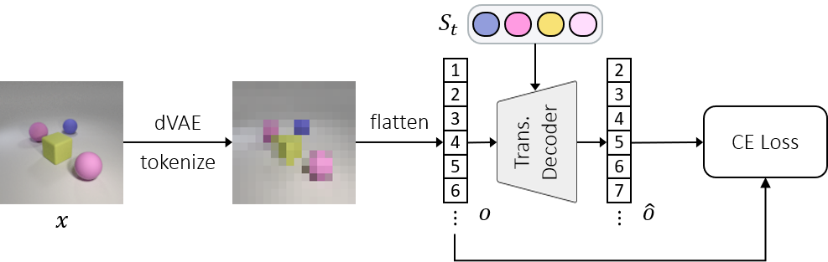
Prior Works – STEVE
STEVE uses an autoregressive (AR) Transformer decoder
Reconstruct pre-trained dVAE tokens
Singh, Gautam, Yi-Fu Wu, and Sungjin Ahn. "Simple Unsupervised Object-Centric Learning for Complex and Naturalistic Videos." NeurIPS. 2022.
Notes:
State-of-the-art method STEVE instead uses an AR Transformer decoder to reconstruct image patch tokens produced by a pre-trained dVAE

Slide 14
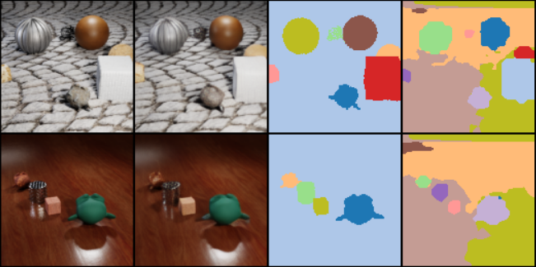
Prior Works – STEVE
STEVE uses an autoregressive (AR) Transformer decoder
Reconstruct pre-trained dVAE tokens
Powerful Transformer + feature-level reconstruction
Work on complex data
Image
GT
Segmentation
Singh, Gautam, Yi-Fu Wu, and Sungjin Ahn. "Simple Unsupervised Object-Centric Learning for Complex and Naturalistic Videos." NeurIPS. 2022.
Notes:
The powerful Transformer arch and the feature-level recon target enables STEVE to segment complicated images

Slide 15
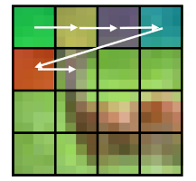
Prior Works – STEVE
Bad reconstruction:
Raster-order AR generation: error accumulation
Ignores the spatial structure of images
Input
Reconstruction
Singh, Gautam, Yi-Fu Wu, and Sungjin Ahn. "Simple Unsupervised Object-Centric Learning for Complex and Naturalistic Videos." NeurIPS. 2022.
Notes:
However, STEVE reconstructions are of low quality. This is because the Transformer-based decoder performs raster-order AR generation, which ignores the spatial structure of images

Slide 16
SlotDiffusion
We want a decoder with both strong modeling capacity (seg.) and generation quality (recon.)
Latent Diffusion Model (LDM)
Rombach, Robin, et al. "High-resolution image synthesis with latent diffusion models." CVPR. 2022.
Notes:
In this work, we focus on improving the slot-to-image recon quality without sacrificing the obj seg results. And we choose Latent Diffusion Model as the slot decoder since it has both strong modeling capacity and high generation quality

Slide 17
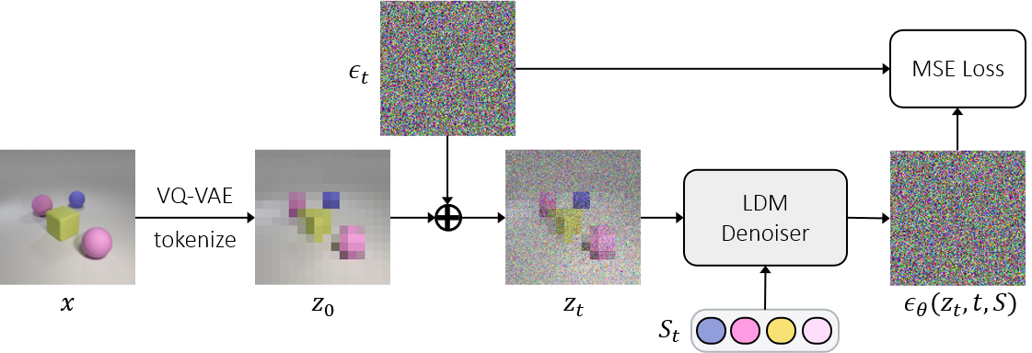
SlotDiffusion
We want a decoder with both strong modeling capacity (seg.) and generation quality (recon.)
Latent Diffusion Model (LDM)
How to condition DM on slots?
Slots are 1D vectors, similar to text embeddings
Cross-Attention (Stable-Diffusion)
Rombach, Robin, et al. "High-resolution image synthesis with latent diffusion models." CVPR. 2022.
Notes:
Now the problem is, how to condition the decoder on slots? We observe that, slots are 1D feature tensors, which are similar to text embeddings. Therefore, we follow text-to-image diffusion models to fuse object slots and image features via cross-attn. Our training loss is thus the slot-conditioned denoising loss

Slide 18
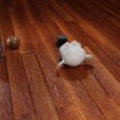
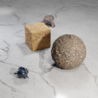
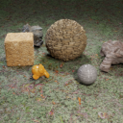
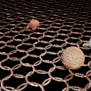
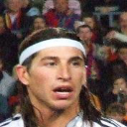

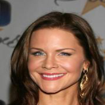

Experiments
CLEVRTex
Datasets:
2 image: CLEVRTex, CelebA
4 video: MOVi-D/E/Solid/Tex
CelebA
MOVi-D
MOVi-Solid
MOVi-E
MOVi-Tex
Liu, Ziwei, et al. "Deep learning face attributes in the wild." ICCV. 2015.
Greff, Klaus, et al. "Kubric: A scalable dataset generator." CVPR. 2022.
Karazija, Laurynas, et al. "Clevrtex: A texture-rich benchmark for unsupervised multi-object segmentation." NeurIPS D&B Track. 2021.
Notes:
Now let’s look at experiments. We evaluate our method on 2 image and 4 video datasets

Slide 19
Experiments
CLEVRTex
Datasets:
2 image: CLEVRTex, CelebA
4 video: MOVi-D/E/Solid/Tex
Baselines:
Image: SA (CNN), SLATE (Transformer)
Video: SAVi (CNN), STEVE (Transformer)
CelebA
MOVi-D
MOVi-Solid
MOVi-E
MOVi-Tex
Liu, Ziwei, et al. "Deep learning face attributes in the wild." ICCV. 2015.
Greff, Klaus, et al. "Kubric: A scalable dataset generator." CVPR. 2022.
Karazija, Laurynas, et al. "Clevrtex: A texture-rich benchmark for unsupervised multi-object segmentation." NeurIPS D&B Track. 2021.
Notes:
For baselines, we select representative models using CNN and Transformer based slot decoder

Slide 20
Experiments
CLEVRTex
Datasets:
2 image: CLEVRTex, CelebA
4 video: MOVi-D/E/Solid/Tex
Baselines:
Image: SA (CNN), SLATE (Transformer)
Video: SAVi (CNN), STEVE (Transformer)
Metrics:
Seg.: FG-ARI, mIoU
Recon.: MSE, LPIPS (VGG perceptual distance)
Gen.: FID (image), FVD (video)
CelebA
MOVi-D
MOVi-Solid
MOVi-E
MOVi-Tex
Liu, Ziwei, et al. "Deep learning face attributes in the wild." ICCV. 2015.
Greff, Klaus, et al. "Kubric: A scalable dataset generator." CVPR. 2022.
Karazija, Laurynas, et al. "Clevrtex: A texture-rich benchmark for unsupervised multi-object segmentation." NeurIPS D&B Track. 2021.
Notes:
We test the segmentation, reconstruction, and generation ability of these models

Slide 21
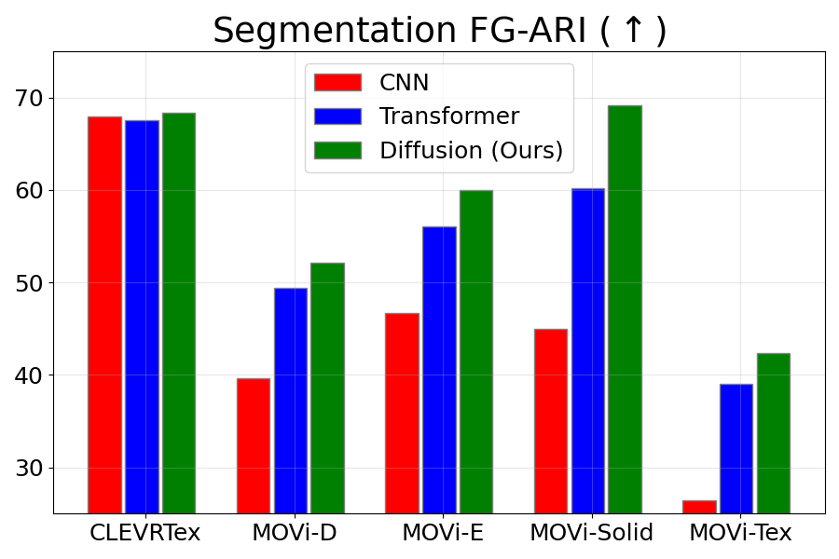
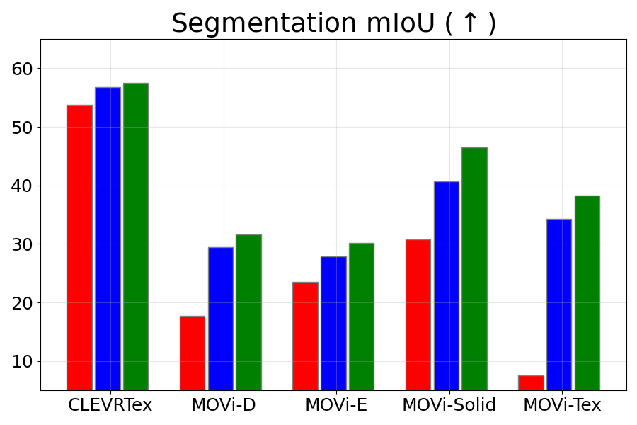
Segmentation – Quantitative
SOTA in both metrics across all datasets
CelebA does not have GT masks
Notes:
First, SlotDiffusion achieves the best segmentation performance on all datasets, proving the strong modeling capacity of diffusion models

Slide 22
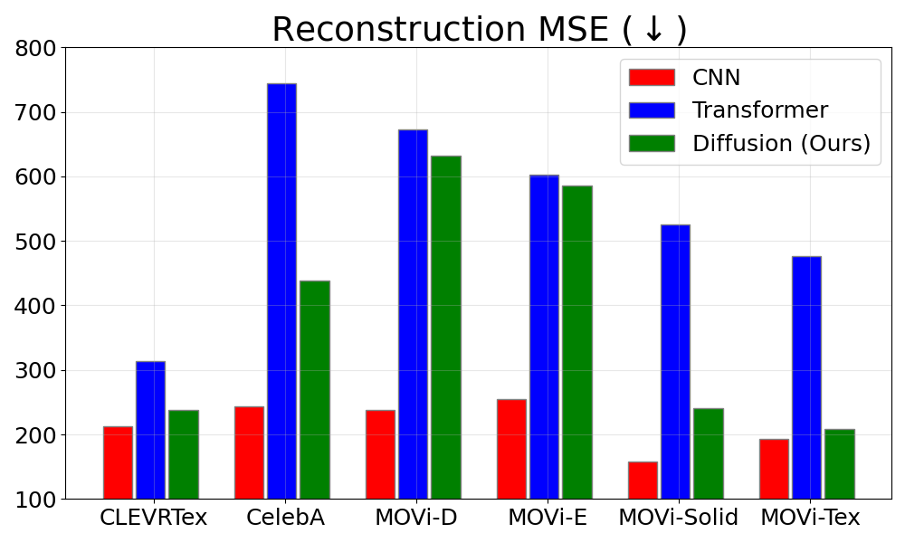
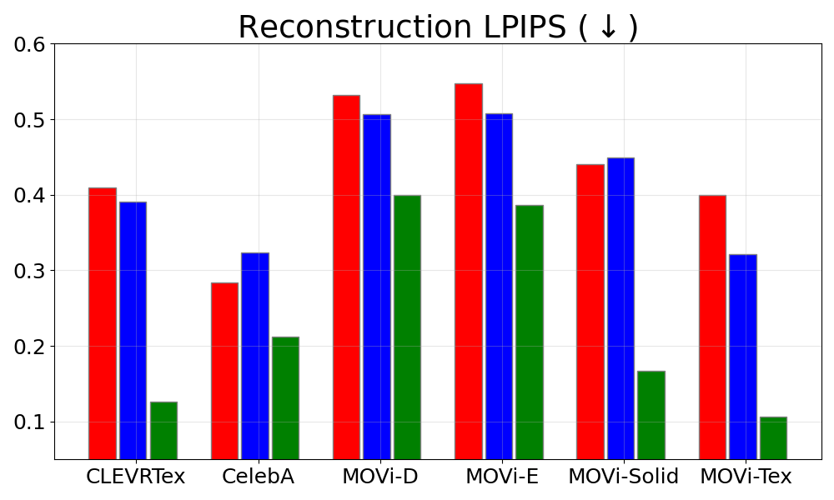
Reconstruction – Quantitative
MSE is 2nd, clear SOTA in LPIPS
MSE is bad – favors blurry results
LPIPS aligns with human perception
Zhang, Richard, et al. "The unreasonable effectiveness of deep features as a perceptual metric." CVPR. 2018.
Notes:
For reconstruction, SlotDiffusion is the 2nd best in terms of MSE, while we achieve clear SOTA in LPIPS which better aligns with human perception

Slide 23
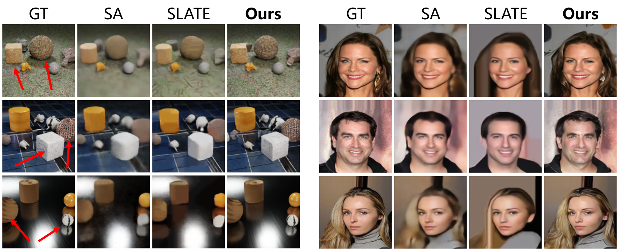
Reconstruction – Qualitative
Baseline results are blurry, while we preserve details such as textures, hairs
CLEVRTex
CelebA
Notes:
Our reconstructed images retain accurate object shapes and detailed textures on the objects and backgrounds

Slide 24
Compositional Generation
We view object slots as visual concepts, and compose them to generate new data
Notes:
With slots, we can perform intuitive compositional generation

Slide 25
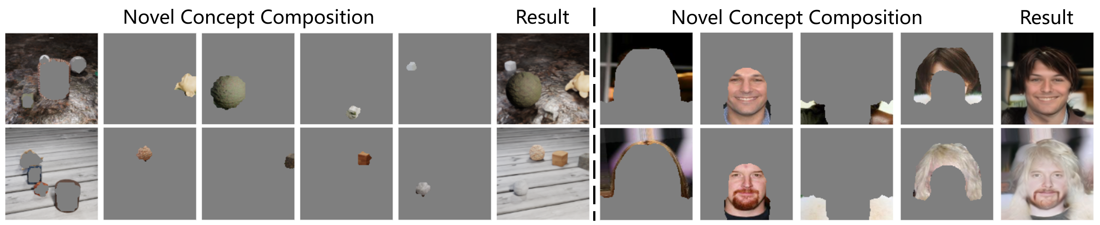
Compositional Generation
We view object slots as visual concepts, and compose them to generate new data
CLEVRTex: objects, background
Notes:
For example, we can compose objects and backgrounds on CLEVRTex

Slide 26
Compositional Generation
We view object slots as visual concepts, and compose them to generate new data
CLEVRTex: objects, background
CelebA: face, hair, clothes, background
Notes:
or human face, hairs, and clothes on CelebA

Slide 27
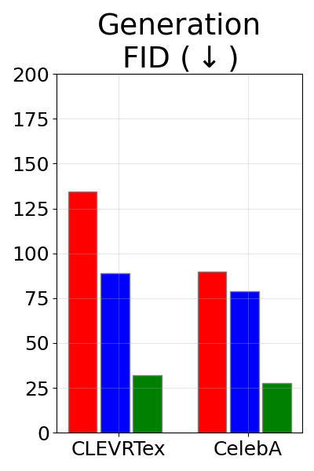
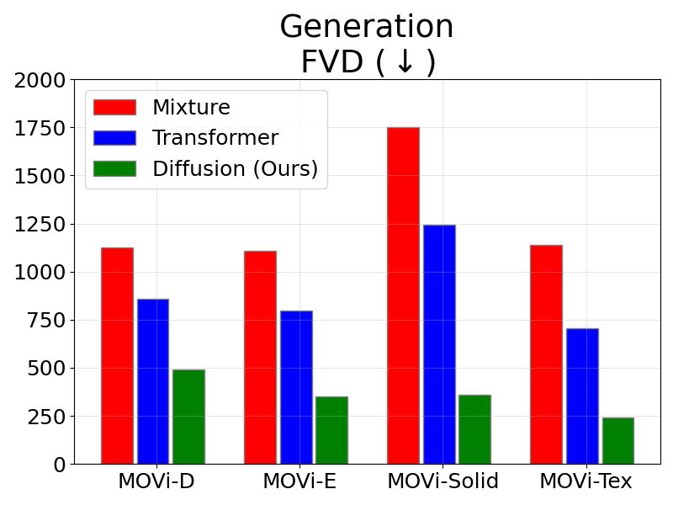
Compositional Generation – Quantitative
SOTA in both metrics across all datasets
Heusel, Martin, et al. "Gans trained by a two time-scale update rule converge to a local nash equilibrium." NeurIPS. 2017.
Unterthiner, Thomas, et al. "Towards accurate generative models of video: A new metric & challenges." arXiv. 2018.
Notes:
Again, SlotDiffusion achieves the best generation results on all datasets

Slide 28
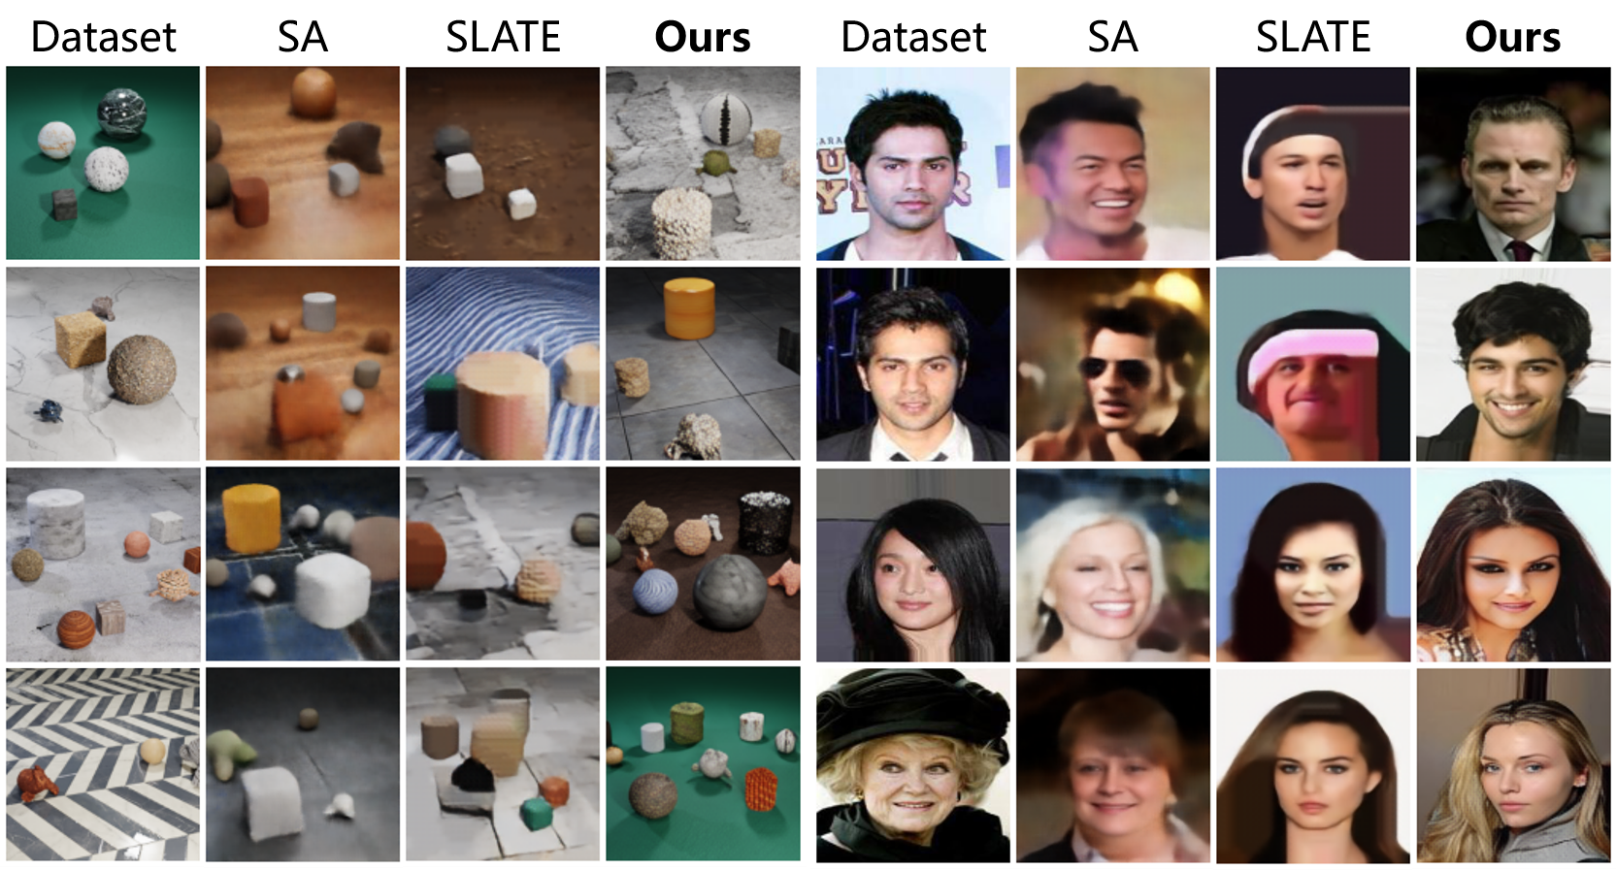
Compositional Generation – Qualitative
Baseline results are blurry, while we generate details such as textures, hairs
CLEVRTex
CelebA
Notes:
Qualitatively, we generate the most photo-realistic images

Slide 29
Application – Video Prediction
We can combine SlotDiffusion with a dynamics model SlotFormer for video prediction
Good visual quality
Correct physics
GT
PredRNN
VQFormer
STEVE+SF
Ours+SF
Notes:
Also, SlotDiffusion can serve as a base model for better video prediction. We combine it with an obj-centric dynamics model SlotFormer, and simulates videos with good visual quality and correct physics

Slide 30
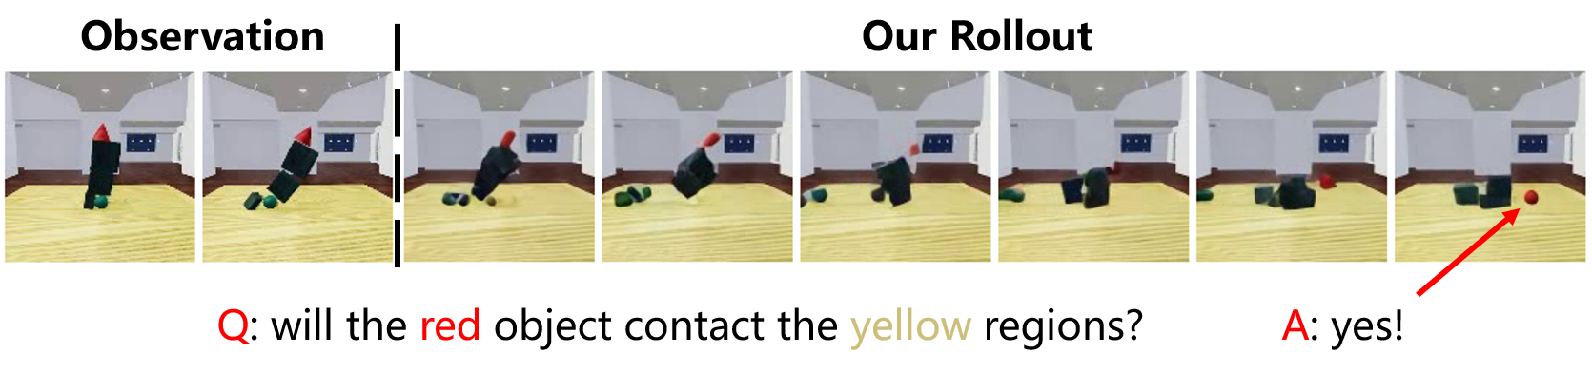
Application – Visual Question Answering (VQA)
We can leverage the video predictor as a world model for question answering
Bear, Daniel, et al. "Physion: Evaluating Physical Prediction from Vision in Humans and Machines." NeurIPS D&B Track. 2021.
Notes:
With the simulated future states, we can now answer questions

Slide 31
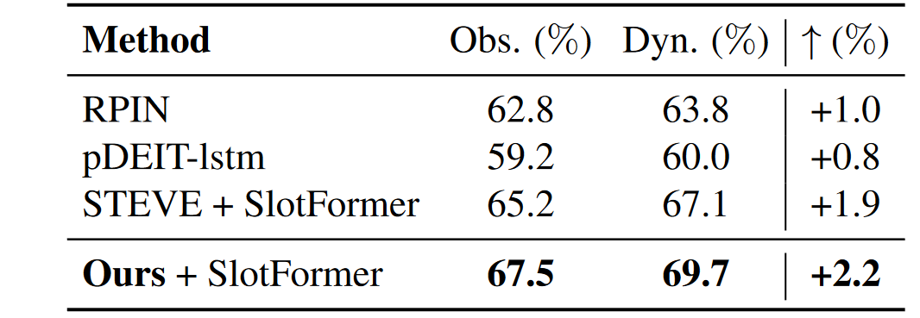
Application – Visual Question Answering (VQA)
We can leverage the video predictor as a world model for question answering
SOTA VQA accuracy on Physion
Bear, Daniel, et al. "Physion: Evaluating Physical Prediction from Vision in Humans and Machines." NeurIPS D&B Track. 2021.
Notes:
Since our slots also contain more useful information, it achieves SOTA performance on Physion VQA dataset.

Slide 32
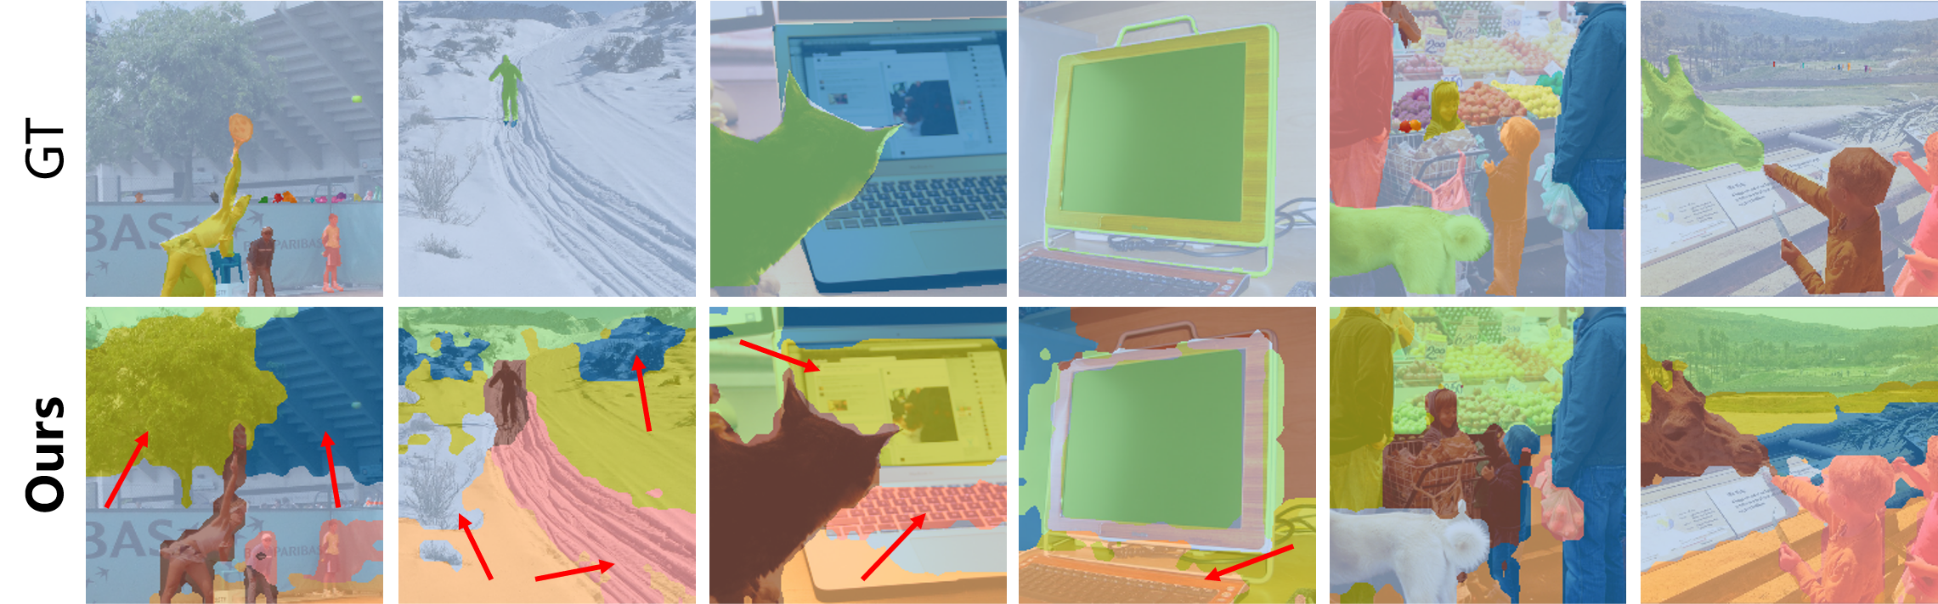
Scale Up to Real-World Data
SlotDiffusion can also be scaled up to real-world datasets!
Replace the image encoder with DINO
Seitzer, Maximilian, et al. "Bridging the gap to real-world object-centric learning." ICLR. 2023.
Lin, Tsung-Yi, et al. "Microsoft coco: Common objects in context." ECCV. 2014.
Notes:
Finally, we show that SlotDiffusion can scale up to real-world datasets such as COCO using a DINO ViT encoder. We can not only segment objects, but also discover unannotated but semantically meaningful image regions

Slide 33

Conclusion
SlotDiffusion: Object-centric learning with a diffusion model decoder
Better segmentation & generation
Downstream applications: Editing, VP, VQA
Scale up to real-world data, e.g. COCO
Future directions
Generate photo-realistic real-world images/videos
Leverage pre-trained DM, e.g. Stable Diffusion?
More results on our project page: https://slotdiffusion.github.io/
Notes:
In conclusion, we present SlotDiffusion, an object-centric model with DM-based slot decoder. In the future, we aim to generate more realistic real-world images and videos by using pre-trained models such as Stable Diffusion. Please check out our project page for more information. Thank you!

